Slide 1

Spring boot
18/06/2020

Slide 2
Agenda
What is Spring Boot?
Features
Developing Spring boot application
Spring boot JPA
Spring Boot View Resolver

Slide 3
What is Spring Boot?
Spring Boot is an open source Java-based framework used to create a micro Service.
Spring Boot makes it easy to create stand-alone, production-grade Spring based Applications that you can "just run".

Slide 4
Features
Create stand-alone Spring applications
Embed Tomcat, Jetty or Undertow directly (no need to deploy WAR files)
Provide opinionated 'starter' dependencies to simplify your build configuration
Automatically configure Spring and 3rd party libraries whenever possible
Provide production-ready features such as metrics, health checks, and externalized configuration
Absolutely no code generation and no requirement for XML configuration

Slide 5
Developing Spring boot application

Slide 6
System requirements
Java 8
Spring boot 2.3.1
IDE - Eclipse IDE-2020
Eclipse IDE 2020 – download link -
https://www.eclipse.org/downloads/download.php?file=/oomph/epp/2020-06/R/eclipse-inst-win64.exe
Spring tool suite – Install for eclipse in eclipse market place.
Mysql 8

Slide 7
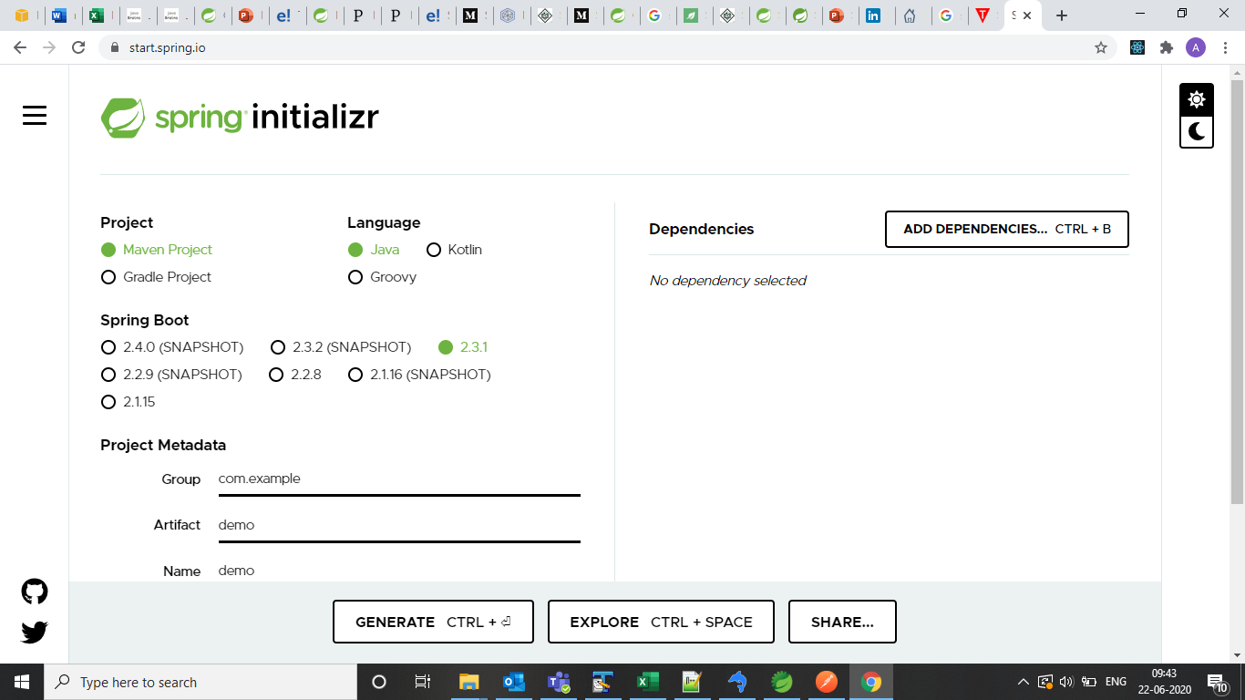
Starting point
Spring initializr easily generates the structure of the Spring Boot Project .
Project can be generated by using https://start.spring.io/

Slide 8
Generating a Project
Spring Initializr UI has the following labels:
Project: It defines the kind of project. We can create either Maven Project or Gradle Project. We will create a Maven Project throughout the tutorial.
Language: Spring Initializr provides the choice among three languages Java, Kotlin, and Groovy. Java is by default selected.
Spring Boot: Select the Spring Boot version. The latest stable version is 2.3.1.
Project Metadata: It contains information related to the project, such as Group, Artifact, etc. Group denotes the package name; Artifact denotes the Application name. The default Group name is com.example, and the default Artifact name is demo.
Dependencies: Dependencies are the collection of artifacts that we can add to our project.

Slide 9
There is another Options section that contains the following fields:
Name: It is the same as Artifact.
Description: In the description field, we can write a description of the project.
Package Name: It is also similar to the Group name.
Packaging: We can select the packing of the project. We can choose either Jar or War.
Java: We can select the JVM version which we want to use. We use Java 8.
There is a Generate button. When we click on the button, it starts packing the project and downloads the Jar or War file, which you have selected.

Slide 10
Folder structure to be followed
pom.xml src
main
java
resources
com
application.properties
eims
Application.java
static
blueprint
CSS
schema
JS
demo
webapp
controller
WEB-INF
service
JSP
dao

Slide 11
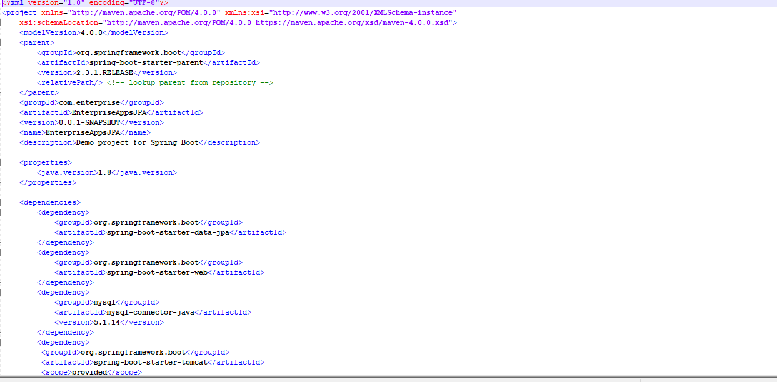
Understanding pom.xml

Slide 12
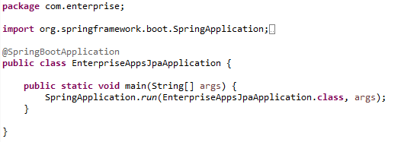
Main application class

Slide 13
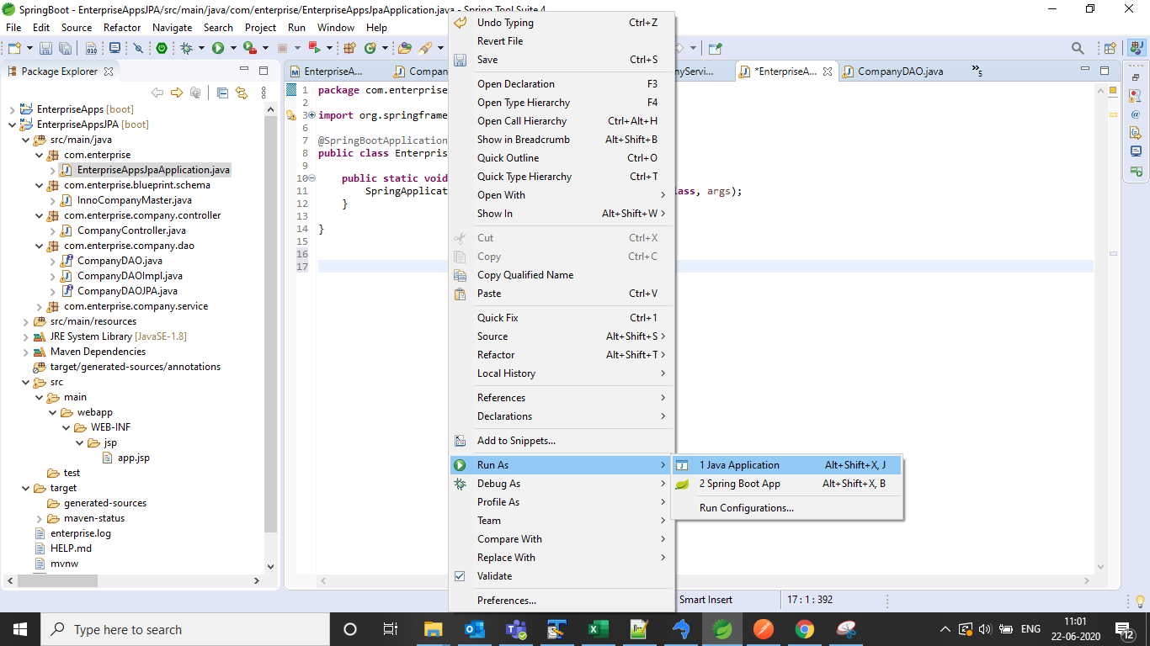
Running the application
Spring Boot application can be run from IDE as a simple Java application.
First perform Maven clean and Maven build .
Right click on main class , run as Java application.

Slide 14
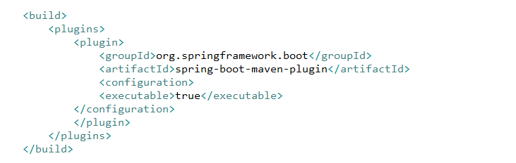
Running as a Packaged Application
If you use the Spring Boot Maven or Gradle plugins to create an executable jar, you can run your application using java -jar, as shown in the following example:
$ java -jar target/myapplication-0.0.1-SNAPSHOT.jar
In Maven project , jar can be build by adding below dependency ,
Jar can be exported by , Run as -> Maven build -> goal -> package

Slide 15
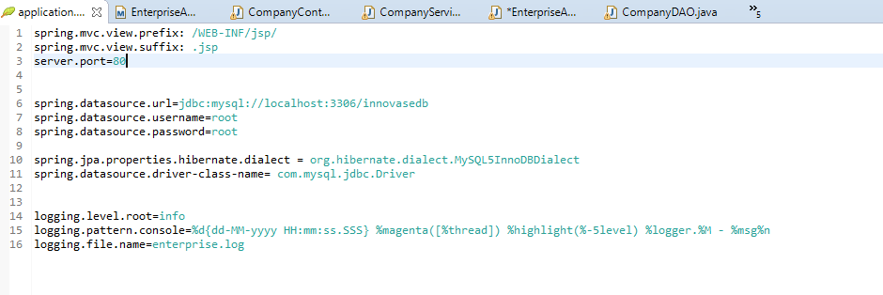
Application Property Files
Spring Boot Framework comes with a built-in mechanism for application configuration using a file called application.properties. It is located inside the src/main/resources folder .
Spring Boot provides various properties that can be configured in the application.properties file.

Slide 16


Database connectivity configuration
While creating spring boot project , MySQL connector dependency can be added as ,
Spring boot project comes by default with MySQL 8 dependency.
Add the connectivity properties in application.properties file for database connectivity ,

Slide 17
Spring Boot JPA

Slide 18
What is JPA?
Spring Boot JPA is a Java specification for managing relational data in Java applications.
It allows us to access and persist data between Java object/ class and relational database. JPA follows Object-Relation Mapping (ORM). It is a set of interfaces.
It also provides a runtime EntityManager API for processing queries and transactions on the objects against the database.

Slide 19
Why should we use JPA?
The main advantage of JPA over JDBC is that, in JPA, data is represented by objects and classes while in JDBC data is represented by tables and records.
It uses POJO to represent persistent data that simplifies database programming. There are some other advantages of JPA:
JPA avoids writing DDL in a database-specific dialect of SQL. Instead of this, it allows mapping in XML or using Java annotations.

Slide 20
Difference between JPA and Hibernate
JPA: JPA is a Java specification that is used to access, manage, and persist data between Java object and relational database. It is a standard approach for ORM.
Hibernate: It is a lightweight, open-source ORM tool that is used to store Java objects in the relational database system. It is a provider of JPA. It follows a common approach provided by JPA.

Slide 21
The following table describes the differences between JPA and Hibernate.
JPA | Hibernate
JPA is a Java specification for mapping relation data in Java application. | Hibernate is an ORM framework that deals with data persistence.
JPA does not provide any implementation classes. | It provides implementation classes.
It uses platform-independent query language called JPQL (Java Persistence Query Language). | It uses its own query language called HQL (Hibernate Query Language).
It is defined in javax.persistence package. | It is defined in org.hibernate package.
It is implemented in various ORM tools like Hibernate, EclipseLink, etc. | Hibernate is the provider of JPA.
JPA uses EntityManager for handling the persistence of data. | In Hibernate uses Session for handling the persistence of data.

Slide 22

Spring Boot JPA Example
Add spring boot starter data JPA dependency ,

Slide 23
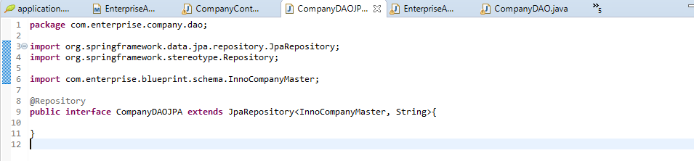
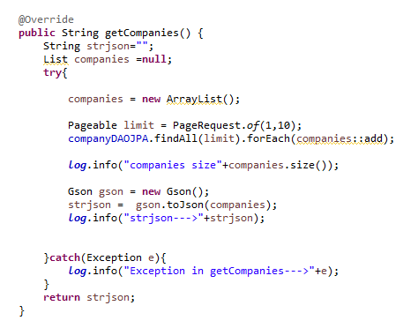
Create DAO Class which extends to JPARepository ,
Create Service Class where JPA class is used to fetch all the records by using findAll

Slide 24
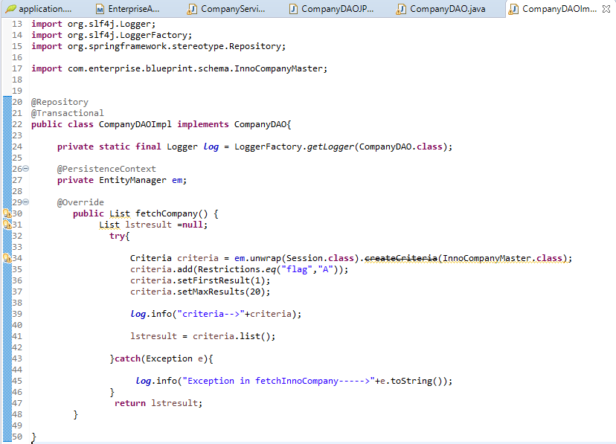
By using Hibernate criteria,
Spring boot starter JPA by default comes with Hibernate .
By using Entitymanager , Criteria can be used as :

Slide 25
Spring Boot Microservices

Slide 26
How to integrate microservices with spring boot ?
For each microservice create separate spring boot project.
One root microservice communicates with other microservices to get necessary information.
Communication can be happened via Rest template or Webclient.
Rest Template is used to create applications that consume RESTful Web Services.
WebClient is an interface representing the main entry point for performing web requests.
WebClient has been created as a part of the Spring Web Reactive module and will be replacing the classic RestTemplate in these scenarios. The new client is a reactive, non-blocking solution that works over the HTTP/1.1 protocol.

Slide 27
Service discovery

Slide 28
Why Service Discovery ?
Because of upgrades in service instances, failure of VMs and/or auto-scaling, services will be dynamically launched from the new network location or removed from existing network locations.
Irrespective of changes to service instance location, the client ( be in the front end or backend ) should be able to call right service all the time and there should not be manual effort involved to maintain and run this.

Slide 29
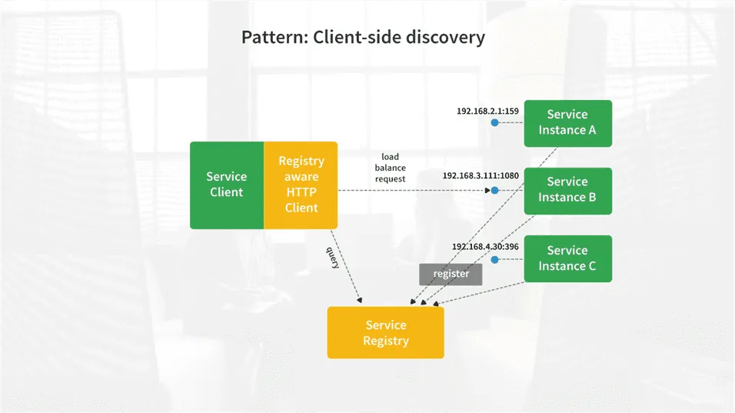
Client-side discovery

Slide 30
In Client side discovery , Client’s responsibility to identify the all available service instances and load balance the requests among all available service instances.
To achieve this, Client makes a query to Service Registry, which knows the all available services instances.
The client uses a load balancing mechanism to find one of the available service instances and sends a request.
Newly created all the network locations of service instances can be registered with the service registry on service instances startup.
The Service instance can be deregistered (deleted) from the service registry on the particular service instance termination.
Netflix OSS supports the client side discovery pattern and Netflix Eureka is the service registry.

Slide 31
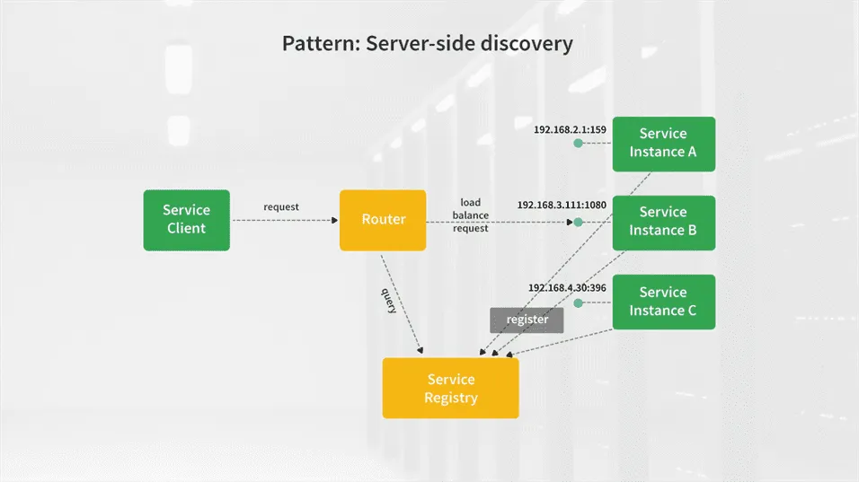
Server-side discovery

Slide 32
In server side discovery , the Client sends a request to a service via a load balancer.
The load balancer makes a query to the service registry and routes each client request to an available service instance.
The newly created service instances can be registered/deregistered with the service registry.
AWS is offering one of the most popular server-side discovery routers i.e The AWS Elastic Load Balancer (ELB).

Slide 33
Eureka Server

Slide 34
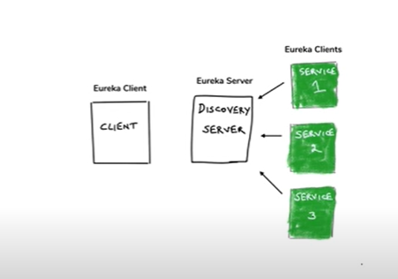
What is Eureka server ?
Eureka Server is an application that holds the information about all client-service applications.
Every Micro service will register into the Eureka server and Eureka server knows all the client applications running on each port and IP address. Eureka Server is also known as Discovery Server.

Slide 35
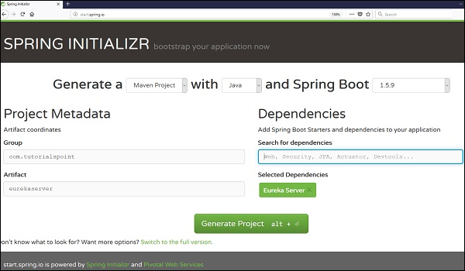
Building a Eureka Server
Eureka Server comes with the bundle of Spring Cloud. For this, we need to develop the Eureka server and run it on the default port 8761.
Visit the Spring Initializer homepage https://start.spring.io/ and download the Spring Boot project with Eureka server dependency.

Slide 36
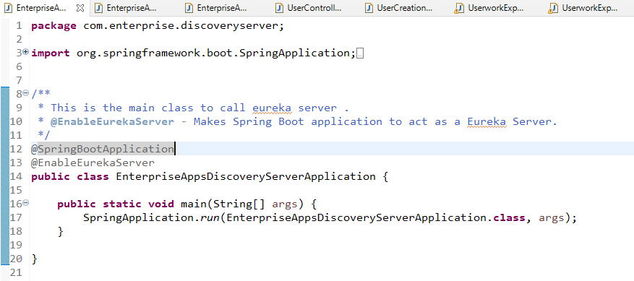
After downloading the project in main Spring Boot Application class file, we need to add @EnableEurekaServer annotation.
The @EnableEurekaServer annotation is used to make your Spring Boot application acts as a Eureka Server.

Slide 37
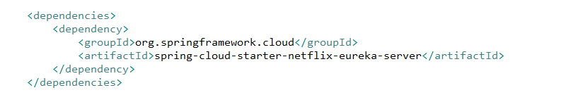
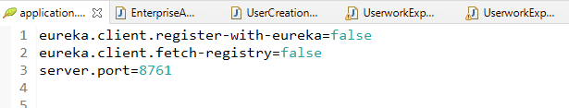
Spring cloud Eureka server dependency in pom.xml is ,
By default, the Eureka Server registers itself into the discovery.
Add the following lines in to application.properties file ,
eureka.client.register-with-eureka=false
eureka.client.fetch-registry=false
server.port=8761

Slide 38
eureka.client.register-with-eureka = false - Makes it so the server does not attempt to register itself.
eureka.client.fetch-registry = false - With this, we inform customers that they must not store the data of the available instances in their local cache. This means that they must consult the Eureka server whenever they need to access a service. In production, this is often set to true to expedite requests. I must comment that this cache is updated every 30 seconds by default.
server.port = 8761 , The port on which the service will listen is specified with server.port

Slide 39
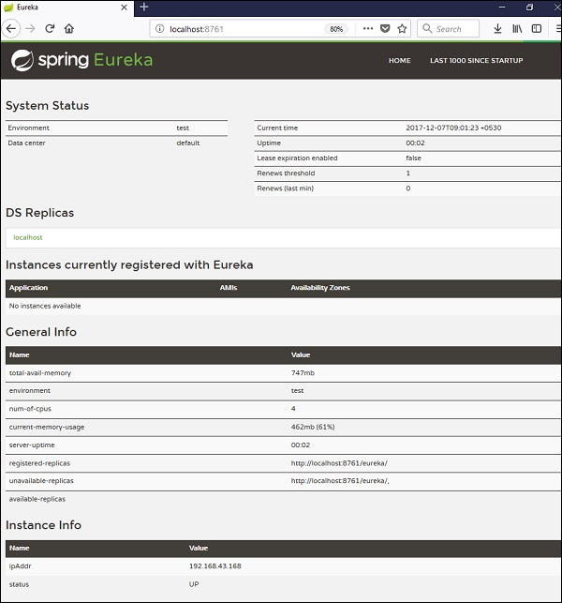
Now hit the URL http://localhost:8761/ in your web browser and you can find the Eureka Server running on the port 8761 as shown below −

Slide 40
What is Eureka client ?
Each microservices can be referred as eureka client.
When a client microservice registers with Eureka it provides metadata such as host, port, and health indicator thus allowing for other microservices to discover it.
The discovery server expects a regular heartbeat message from each microservice instance.
If an instance begins to consistently fail to send a heartbeat, the discovery server will remove the instance from his registry.

Slide 41
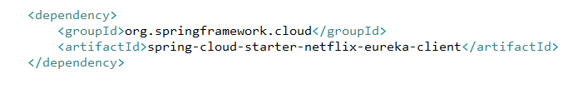
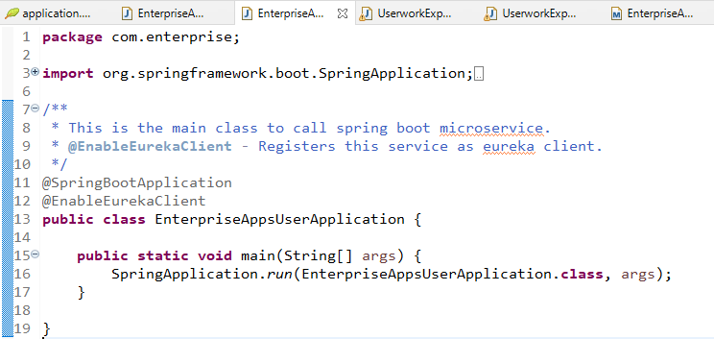
Configuring Eureka client
To register microservice with Eureka server following dependency added in pom.xml ,
Add @EnableEurekaClient annotation in main Spring Boot Application class file. With this annotation, this artifact will act like a spring discovery client and will register itself in the eureka server attached to this service.

Slide 42
Eureka Client/Server Communication
At first, while the Eureka client is bootstrapped, it tries to talk with the Eureka server in the same Zone. So, suppose a Eureka client instance is in the Asia Zone — it tries to connect to the Asia Zone's Eureka server. If it is not available, then it fails over to another Zone.
It determines its targets using the eureka.client.serviceUrl.defaultZone property, so we need to give a URL of the same Zone's Eureka server.
Add following lines in application.properties file ,
eureka.client.serviceUrl.defaultZone=http://localhost:8761/eureka
spring.application.name = countries-service
with the parameter eureka.client.serviceUrl.defaultZone, we specify where the Eureka server is. Spring Boot automatically detects that you have the package Eureka Discovery available and tries to register with the corresponding server.

Slide 43
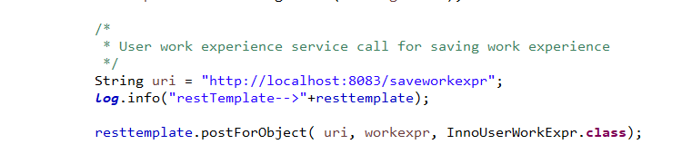
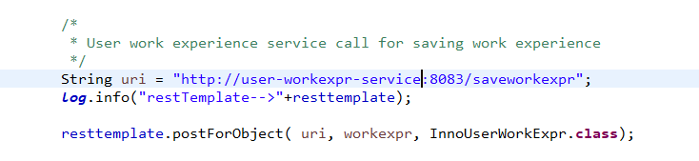
Calling Service which registers as Eureka client
Before registering service as Eureka client , URL is hardcoded to call another service API .
After registering service with Eureka client , service API can be called by application name instead of hardcoding the URL as,
user-workexpr-service is the application name specified in work experience service application.properties .

